Slide 1
Requesting a Fixed Visit Verification Device
Notes:
Welcome to Requesting a Fixed Visit Verification Device training. In this training we will be using PowerPoint slides to review policy and the Sandata function. I will then be doing a demonstration in our Sandata training portal. The information that will be shown in the Sandata training portal is for training purposes only and will not contain any real client information.

Slide 2
Agenda
Fixed Visit Verification (FVV) Overview
FVV Requirements
How to Request an FVV Device
FVV Device Information
How to Request FVV Device Demonstration
Resources
Notes:
Fixed Visit Verification (FVV) Overview
FVV Requirements
How to Request an FVV Device
FVV Device Information
How to Request FVV Device Demonstration
Resources

Slide 3
FVV Overview
Notes:
FVV Overview

Slide 4
FVV Overview
An FVV device is the data collection method of last resort.
FVV uses a small electronic device that is adhered to a surface in the home.
The FVV device generates a six-digit value representing the time and date of the visit.
The generated values must be used when the employee calls in from any phone at a later time to record the visit.
Notes:
An FVV device is the data collection method of last resort, since most visits can be captured using the other two methods: Sandata Mobile Connect (SMC) and Telephonic Visit Verification (TVV).
FVV uses a small electronic device that is adhered to a surface in the home. The device will come with double-sided tape so it can be affixed to a surface. This could be a drawer, a desk, a wall, etc.
The FVV device generates a six-digit numeric visit verification value representing the time and date of the visit.
The generated values must be used when the employee calls in from a phone at a later time to record the visit.
A device can only be paired between one client and provider agency or fiscal employer agency (FEA). If there are multiple clients in the home, or multiple agencies supporting a client, a different device will be needed for each pairing.

Slide 5
FVV Requirements

Slide 6
FVV Requirements (1)
When ordering an FVV device, the provider agency or fiscal employer agency (FEA) must attest that:
Services are anticipated to be authorized for more than 60 days.
The client does not have a landline or Voice over Internet Protocol (VoIP) home phone.
The client or employee does not have a smart phone or tablet device that would support Sandata Mobile Connect.
The client does not have a smart phone or tablet that is available for electronic visit verification (EVV) purposes.
Notes:
We’ll cover how to order the device in a few slides.
When ordering an FVV device, the provider agency or fiscal employer agency (FEA) must attest that:
Services are anticipated to be authorized for more than 60 days.
The client does not have a landline or Voice over Internet Protocol (VoIP) home phone.
The client or employee does not have a smart phone or tablet device that would support Sandata Mobile Connect for mobile visit verification data collection.
The client does not have a smart phone or tablet that is available for electronic visit verification (EVV) purposes.

Slide 7
FVV Requirements (2)
Devices must be returned to Sandata if:
The employee has access to another EVV method.
The client is no longer authorized to receive services.
The provider agency or FEA is no longer authorized to provide the services.
Notes:
Devices must be returned to Sandata if:
The employee has access to another EVV method.
The client is no longer authorized to receive services.
The provider agency or FEA is no longer authorized to provide the services.
Sandata will send the return package to the client’s home.
DHS will be monitoring the usage of FVV devices.

Slide 8
FVV Requirements (3)
To return the device or for any device malfunction, contact the Wisconsin EVV Customer Care center.
The Department of Health Services will be monitoring the usage of FVV devices.
The Department of Health Services may request a device be returned if not being used.
Notes:
To return the device or for any device malfunction, contact the Wisconsin EVV Customer Care center.
If the device is not used for six months, the Department of Health Services will request the device’s return.
Sandata will send the return package to the client’s home.
DHS will be monitoring the usage of FVV devices.
At this time, there is no charge for the FVV devices.

Slide 9
FVV Requirements (4)
To request a return of the FVV device, provide the:
Sandata agency ID.
Agency name.
Agency’s Medicaid ID number.
Client name or ID.
FVV device serial number.
Reason for return.
Return address if different than the client’s address.
Notes:
In the event FVV is needing to be returned and not replaced (no longer needed, services ending etc), Information needed to request the return includes:
Agency ID - STX
Agency Name
Agency Medicaid ID Number
Client Name or ID
FVV Device Serial
Reason For Return – for example, broken or the provider no longer serving this client.
Return Address only if different than the client, for example if the employee returns the device to the agency office.

Slide 10
How to Request an FVV Device

Slide 11
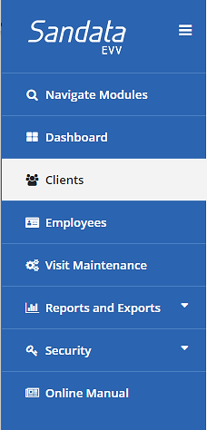
How to Request an FVV Device (1)
Log in to the Sandata EVV Portal.
From the navigation panel, click Clients to access client records. The Client/Program search screen will be displayed.
Notes:
To request an FVV device:
Log in to the Sandata EVV portal.
From the navigation panel, click Clients to access client records. The Client/Program search screen will be displayed.

Slide 12
How to Request an FVV Device (2)
Search for client.
Click Edit next to the desired client name.
Notes:
Search for the client and click the edit icon for the client needing a FVV device.

Slide 13
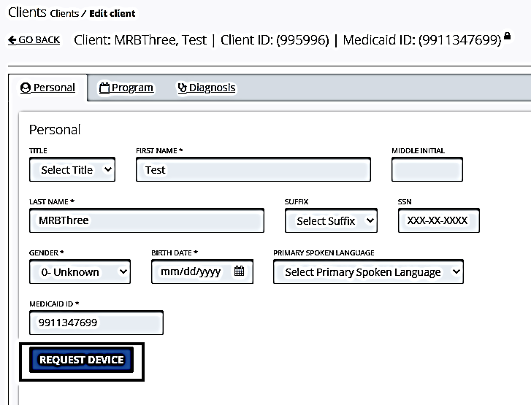
How to Request an FVV Device (3)
Click Request Device.

Slide 14
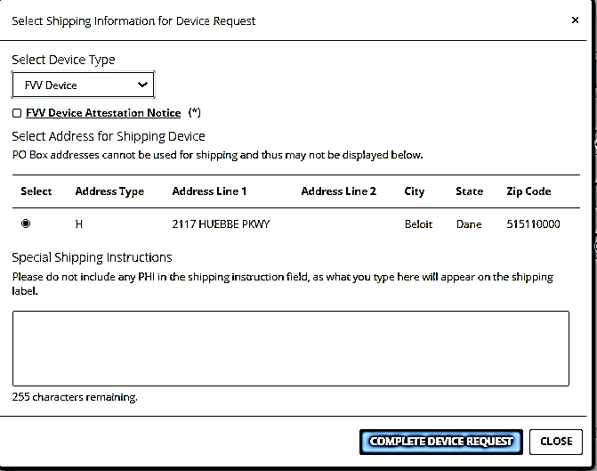
How to Request an FVV Device (4)
Select FVV Device from the Select Device Type drop-down menu.
Notes:
“MVV Device” will appear. However, Wisconsin is only using the FVV device.
Be sure to select “FVV” in order for the request to be filled.
Special instruction will appear on the shipping label and could include delivery instructions such as ‘go to side door and ring bell’, "c/o Guardian or employee Name" or most likely left blank.

Slide 15
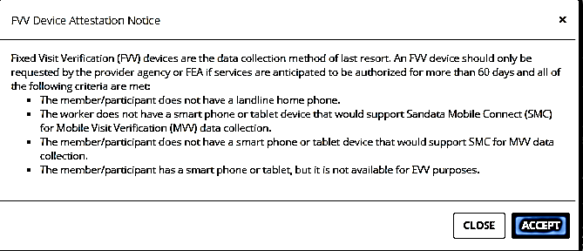
How to Request an FVV Device (5)
Click the FVV Device Attestation Notice title to view the FVV conditions and select Accept.
Check the FVV Device Attestation Notice box to attest to the conditions
Notes:
The attestation check box must be completed in order to complete the order of the device.
Providers can click the FVV Device Attestation Notice title and a pop-up box will appear with the conditions.

Slide 16
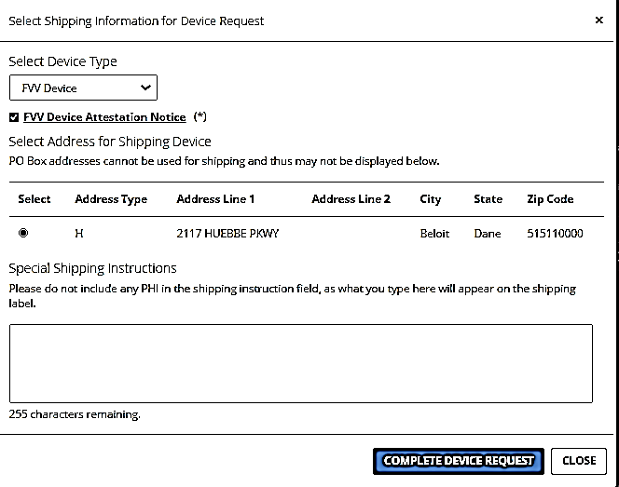
How to Request an FVV Device (6)
Verify the address for mailing.
If the address is incorrect, go back to the Edit Client screen and add a new address. The new address will now show as an option to select in the Request Device screen.
Notes:
Agencies should verify the address is correct before requesting the device. As a reminder, any address changed or added in the Sandata portal will not flow back to DHS. Clients should be encouraged to update their permanent address in their Wisconsin Medicaid Access account or through their income maintenance employee or tribal agency.
See the Client Module PowerPoint for more information about adding an address for a client.

Slide 17
How to Request an FVV Device (7)
Click Complete Device Request.
Notes:
Agencies should verify the address is correct before requesting the device.

Slide 18
How to Request an FVV Device (8)
Click OK to confirm the request.
Click OK on the next screen to finish the process.

Slide 19
FVV Device Information

Slide 20
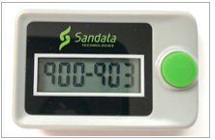
FVV Device Information(1)
The device will be sent to the address selected with instructions for the client and the employee.
The device must remain in the client’s home until it is no longer needed.
The device must be affixed to a surface within the client’s residence.
Notes:
The device will be mailed to the address listed in the Sandata Portal and selected. It will take approximately 3-5 days for FVV devices to arrive at the client’s address from the date the device was requested.
The FVV Call Reference Guide and the instructions for employees to use with the FVV device will arrive in the mailing envelope with the device. The provider agency will need to make sure employees have access to this sheet and the device. There is a sample of the FVV Call Reference Guide on the training web page in the “Training Workers" section.
The device collects the required data of “where” care occurred by being in the client’s home. The device will come with double-sided tape so it can be affixed to a surface. This could be a drawer, a desk, a wall, etc.

Slide 21
FVV Device Information (2)
The device is paired to a client and a provider agency or FEA.
The device will come labeled with the Sandata client ID and Sandata provider agency ID.
If multiple provider agencies are providing services to the same client, each provider agency must order an FVV device if needed, specifically for their employees to use.
Multiple employees from the same agency will use the same FVV device.
Notes:
FVV devices will arrive at the client’s address selected within 3-5 days. Verify the device received is labeled with both the Sandata client ID and Sandata agency ID. These ID numbers will appear on the top and side of the device. The serial number will be on the back side of the device.
Multiple employees from the same agency will use the same FVV device.

Slide 22
How to Request an FVV Device Demonstration

Slide 23
Resources

Slide 24
Resources
EVV Customer Care at 833-931-2035​, Monday – Friday, 7 a.m. – 6 p.m.​
Email support at VDXC.ContactEVV@wisconsin.gov​
EVV webpage at https://www.dhs.wisconsin.gov/evv/index.htm for information about:​
Training Resources​
EVV in Wisconsin​

Slide 25
Thank You

